Slide 1

Lean Methodology: Process Improvement
A Practical Process Mapping Exercise

Slide 2
What is Lean?
Lean is a proven methodology focused on maximizing customer value by eliminating waste (Muda) and driving continuous improvement.
The 7 Types of Waste
Core Principles
01
Transport
Create exceptional customer value
Unnecessary movement of materials
Optimize process flow
Eliminate all forms of waste
02
Continuous improvement (Kaizen)
Inventory
Excess stock and supplies
03
Motion
Inefficient human movement
04
Waiting
Idle time between steps
05
Over Production
Making more than needed
06
Over Processing
Doing more than required
07
Defects
Errors requiring rework

Slide 3

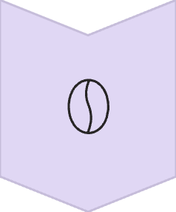

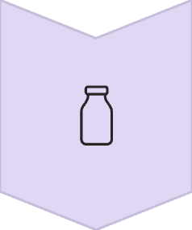

Process Map Example: Making Coffee
Boil Water
Heat water to optimal brewing temperature
Grind Coffee
Prepare fresh coffee grounds
Brew Coffee
Extract coffee flavor through brewing
Add Extras
Customize with sugar or milk (optional)
Serve Coffee
Deliver finished product
Each step maps sequentially, creating a clear visual flow that reveals improvement opportunities

Slide 4

Identifying Waste in the Process
Waiting
Standing idle while coffee brews—missed opportunity to multitask and prepare other items
Motion
Walking across the kitchen multiple times to gather ingredients—inefficient layout creates unnecessary steps
Overproduction
Brewing a full pot when only one cup is needed—wasted coffee and energy
Overprocessing
Stirring coffee excessively beyond what's needed—adds no value to the final product

Slide 5





Process Improvement Opportunities
Eliminate Waste Through Smart Changes
Optimize Waiting
Prepare ingredients while brewing—turn idle time into productive time
Reduce Motion
Create organized coffee station—keep everything within arm's reach
Right-Size Production
Brew exact amount needed—eliminate waste and save resources
Simplify Processing
Limit stirring to once—remove unnecessary steps that add no value

Slide 6

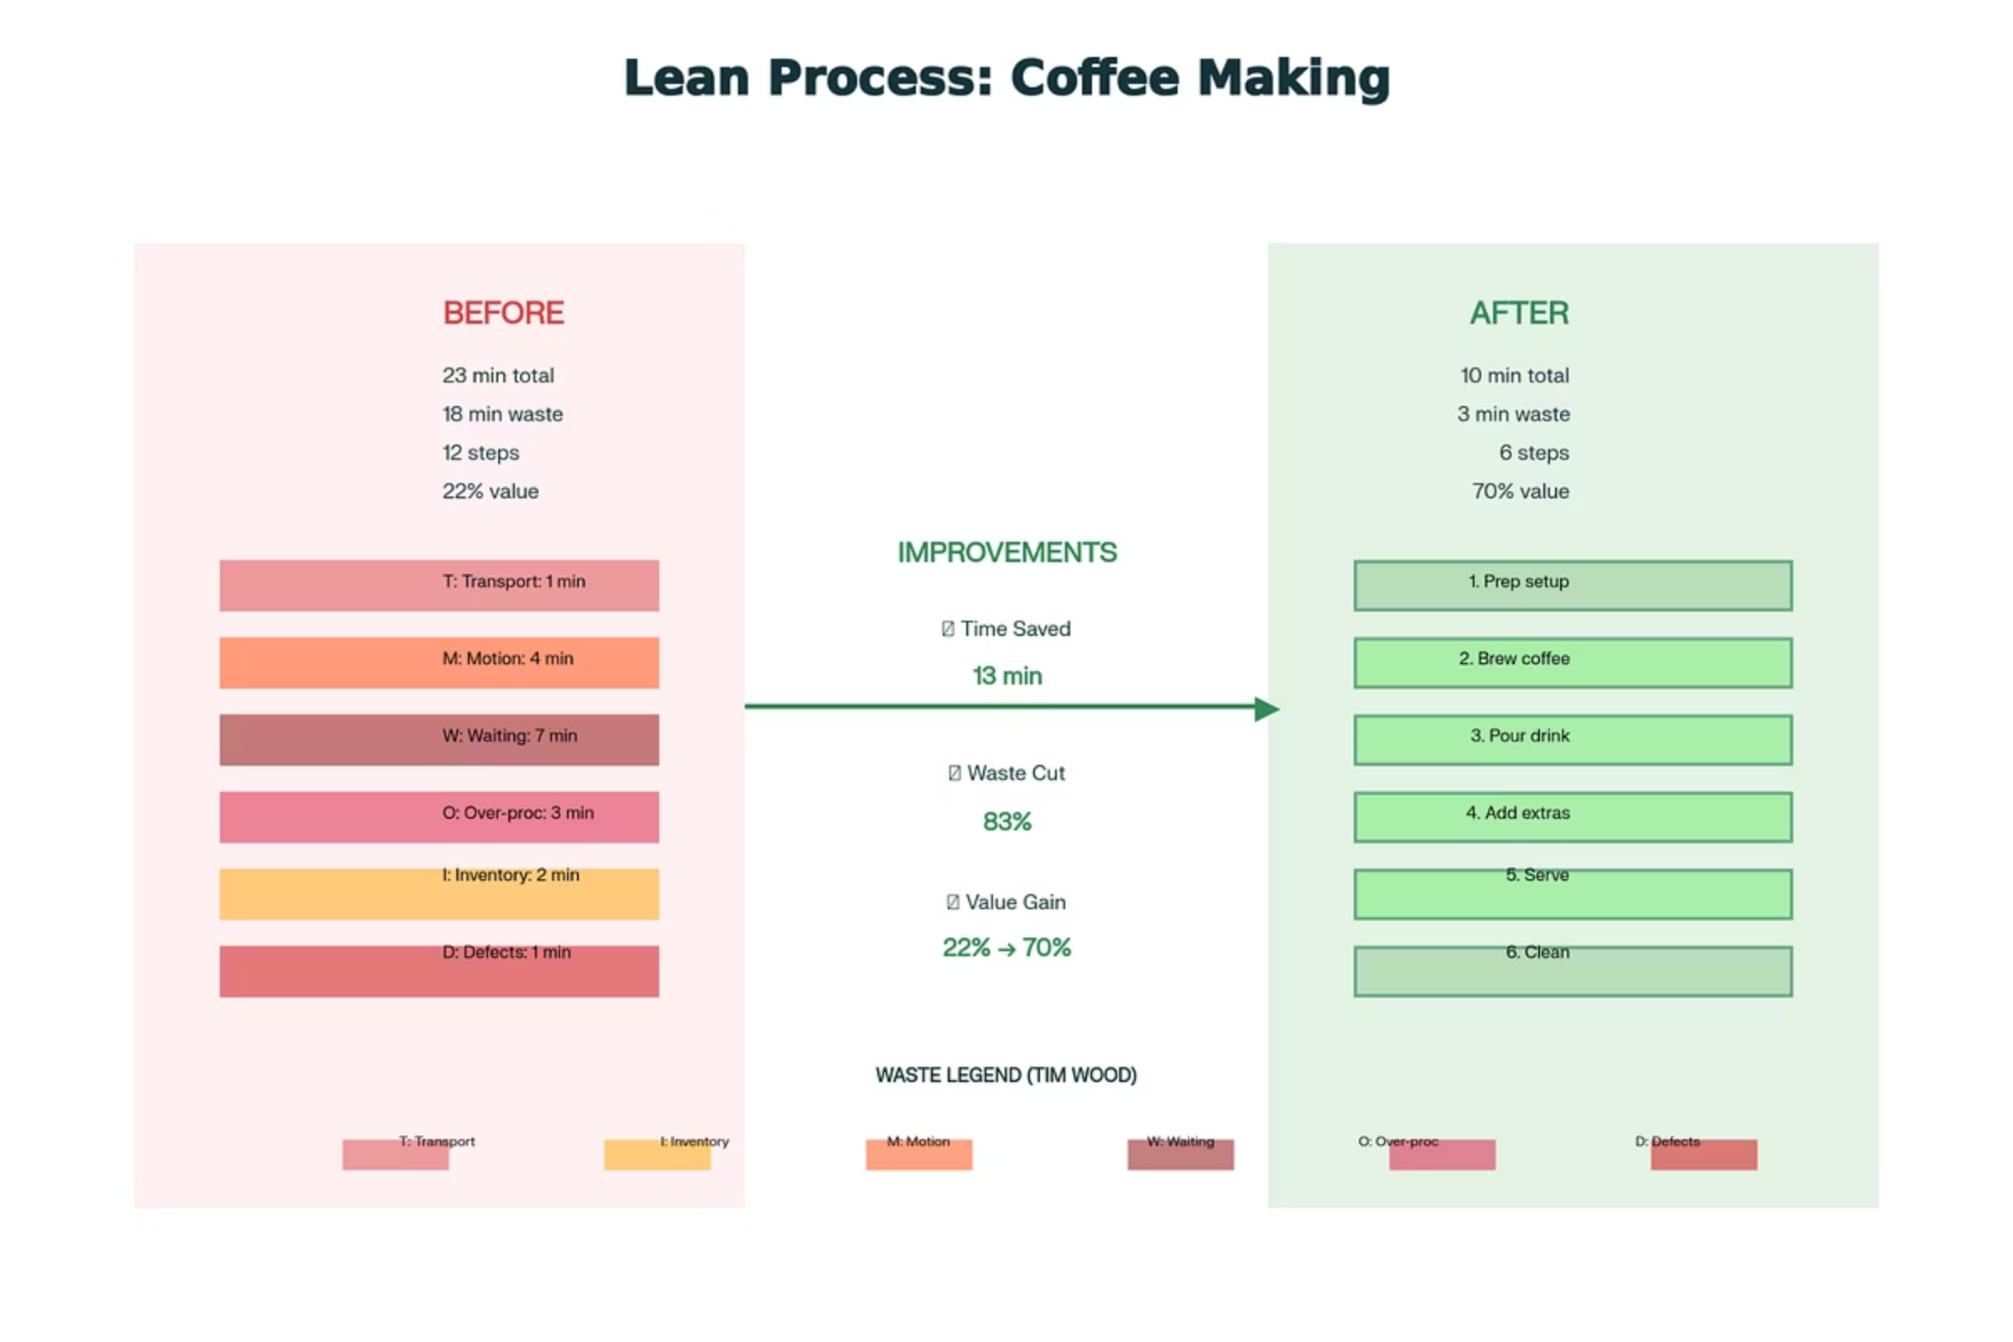
After Lean Process: Coffee Routine
40%
60%
50%
Time Saved
Less Motion
Waste Reduction
Reduced process time through efficient workflow
Fewer steps with optimized station layout
Eliminated overproduction and excess processing
The streamlined process delivers the same quality coffee with significantly less waste and greater efficiency

Slide 7
Before & After Lean Process: Coffee Routine
Before Lean Process
After Lean Process
The Challenge
40%
60%
Disorganized workspace
Multiple trips across kitchen
Time Saved
Less Motion
Idle waiting time
Reduced process time through efficient workflow
Fewer steps with optimized station layout
Excessive coffee brewed
50%
Hidden Costs
Wasted time and energy
Waste Reduction
Unnecessary movements
Resource inefficiency
Eliminated overproduction and excess processing
Frustration and delays
The streamlined process delivers the same quality coffee with significantly less waste and greater efficiency.

Slide 8

Conclusion
Small Changes, Big Impact
Eliminate Waste
Identify and remove the 7 types of waste to unlock efficiency gains
Apply Lean principles to any process—from coffee brewing to complex operations
Continuous Improvement
Embrace Kaizen—small, incremental improvements compound into significant results
Your Turn
Map your own routine process, identify waste, and apply Lean thinking to streamline operations and maximize value

